Slide 1

Laptop Market Analysis

Slide 2
About me
I completed my MBA from Christ University Bangalore on LOS (Lean Operations and systems)
Worked as Research analyst and SAP Consultant for over 5 years
I wanted to restart my career after a break, so using this time to upskill where the technology is heading. DS interests me as it combines technology, analytical thinking and problem solving. Also I see data science and AI becoming increasingly important across industries, so i wanted to use this time to develop a new skill set and create a stronger foundation for my return to work

Slide 3
Agenda
Introduction
Business Problem Statement
Project Objective
Website Selection & Data Source
Web Scraping Methodology
Technologies & Libraries Used
Data Collection Process
Raw Dataset Overview
Data Cleaning & Preprocessing
Exploratory Data Analysis (EDA)
Key Analysis Questions (Use Cases)
Visualizations & Insights
Conclusion & Key Findings
Challenges Faced During the Project
Future Improvements
Q&A

Slide 4
Introduction:
This project focuses on collecting laptop product information available in Amazon India
Amazon offers wide range of laptops from various brands with processors, RAM configurations, storage capabilities and price range
With these multiple options it was difficult to understand how they are influencing the pricing
For my project I have considered, Brand, Processor, RAM, Storage, Screen size, discounts, ratings and price as key parameters and analyzed the collected data to identify the pricing patterns and relationship between the above specifications and price along with each parameter comparison
  Processor comparison
  RAM comparison
  SSD comparison
  Brand comparison
  Premium laptops
Problem Statement:
Amazon has various Laptop brands across different price segments and specification ranging from affordable to high end premium laptops.
The problem statement is to:
  Identity the laptop pricing patterns across the brands
  How different processors prices compare
  RAM and SSD capacity varies across products and their relationship with price
  Analyse discounts offered on laptops
  Examine customer ratings across different laptops
  Characteristics associated with premium laptops
Used scraped Amazon India laptop to Identify these market patterns

Slide 5
Project Objective:
The main objective of this project is to collect, clean, analyse and visualize laptop market data from Amazon India and identify the relationships between laptops specifications, Brands and pricings
Collected laptop products information from Amazon India
Extract product attributes: Brand, Processors, RAM, SSD/Storage, Screen size, Price, Discount, Ratings
Clean and standardize the scraped data
Handling missing values, Inconsistent, Duplicate values
Analyze Brand-wise pricing
Perform Brand, Processor, RAM, SSD comparison across products available
Analyse relationship between RAM and Price
Identify and analyse premium laptops based on their price
Visualize the findings using appropriate charts
Website Selection & Data Source:
Website Selection: Amazon India
Website URL https://www.amazon.in
Data Source: the data was collected from Amazon India Laptop search result page and used publicly available information through amazon search results
Main attributes collected
  Brand_name
  Processor
  RAM
  SSD
  Screen_Size
  Price Discount
  Rating

Slide 6
Data Collection Process:
The Data collection process includes the following steps
Access Amazon Laptop search pages
Selenium is used to open Amazon India Laptop search results pages and the browser dynamically generated web pages [driver.get(url)]
Obtain Page source
The loaded HTML was obtained using Selenium html = driver.page_source
Parse the HTML
BeautifulSoup is used to parse the HTML[ soup = BeautifulSoup(html, "html.parser")]
Product Listing
Laptop search result containers were identified using their HTML attributes [ products = soup.find_all("div", attrs={"data-component-type": "s-search-result"})]
Extract product Information
Extract available information of all attributes from each product listings [re.findall(.....)]
Store the Data
The extracted information is stores in Python list and then converted into a Pandas DataFrame [df=pd.DataFrame(...)]
Save the Dataset
The collected data was saved for further processing and exploratory data analysis

Slide 7
Web Scraping Methodology:
Used automated web scraping to collect laptop information from Amazon India. Scraping process followed was:
10 search results were scrapped to collect large sample of Laptop listings using for loop to https://www.amazon.in/s?k=laptops&page={page}
Regular expression is used to extract the required attributes
Technologies & Libraries Used:
Programming Language: Python
Libraries:
  Selenium : Automating Browser Interaction and Loading webpages
  BeautifulSoup : Parsing HTML and extracting product information
  Pandas : Data Frame, Data Manipulation and Analysis
  NumPy : Missing-value handling
  Regex : Extracting specifications from HTML text
  Matplotlib : Data Visualization
  Seaborn : Statistical Visualization
Amazon India
Laptop Search Results
Load Webpage using Selenium
HTML/Page Source
Parse HTML using BeautifulSoup
Create Pandas DataFrame & Save Dataset
Store Extracted Data using python Lists
Extract Product Attributes using regex
Identify Individual Laptop Listings

Slide 8
Raw Dataset Overview:
The raw dataset contains laptop listings collected from Amazon india
The main attributes being: Brand, processor, RAM, SSD, Sceen_size, Price, Discount and Rating
Before cleaning the Raw dataset extracted contains several inconsistencies like:
  Missing processor, RAM, SSD, Screen_size Information
  Different formats of attributes
  Captured unnecessary information after attributes
  Incomplete extraction of data
Hence further cleaning of data is required before performing the analysis
Data Cleaning & Preprocessing:
The scraped data was cleaned to make is suitable for analysis
Missing value analysis
Cleaning all attributes
  Brands: Overlooked at few Brand names like Ebook, Alienware, Primebook and MSI
    Brand names were standardized
  Processor: A separate Processor_group is created for processor comparison
  RAM: df['RAM'] = df['RAM'].str.extract(r'(\d+)', expand=False) & df['RAM'] = pd.to_numeric(df['RAM'])
  SSD: df['Storage_GB'] = df['SSD'].str.extract(r'(\d+(?:\.\d+)?)') & df['Storage_GB'] = pd.to_numeric(df['Storage_GB'])
  Screen_Size: df['Screen_Size'] = pd.to_numeric(df['Screen_Size']) & df['Screen_Size'] = df['Screen_Size'].round(1)
    Converted TB values to GB and a separate storage-type column is created
  Price: df['Price']=df['Price'].str.replace('[₹,]','',regex=True) & df['Price']=pd.to_numeric(df['Price'])
  Discount = df['Discount'] = df['Discount'].str.extract(r'(\d+)%') & df['Discount'] = pd.to_numeric(df['Discount'])
  Rating: df['Rating']=pd.to_numeric(df['Rating'])

Slide 9
Exploratory Data Analysis:
EDA is performed to understand the distribution of laptops, specifications and prices from the dataframe. The analysis is focuses on below areas:
Brand Comparison
Brand-wise pricing
Processor Comparison
RAM vs Price
SSD Comparison
Premium laptop Analysis
Overall Price Distribution
Statistical summaries and visualizations were used to identify the patterns and relationships within the laptop market
Key Analysis and questions:
Questions used for the analysis
Brand Analysis:
  which brands have highest number of listings
  How pricing vary across brands
Processor Analysis
  Most commonly available processor family
  How does laptop price vary across processor
RAM Analysis
  Most common RAM capacity in the market
  How does laptop price vary with RAM capacity
SSD/Storage Analysis
  Most common storage capacity in the market
  How does laptop price vary with Storage capacity
Premium Laptop Analysis
  Common characteristics among premium laptops
  Common characteristics found in premium price segments

Slide 10
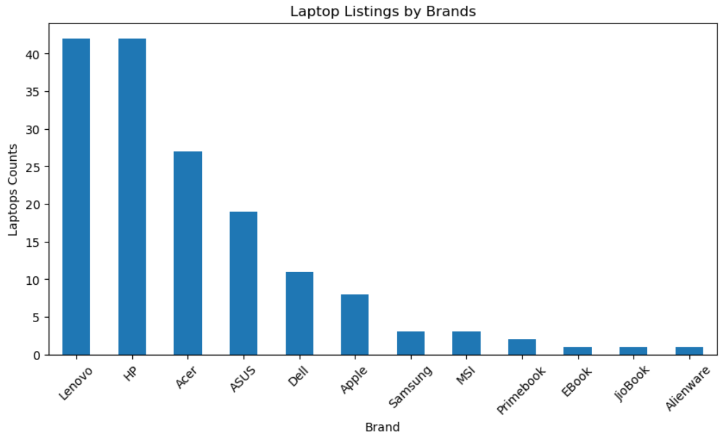
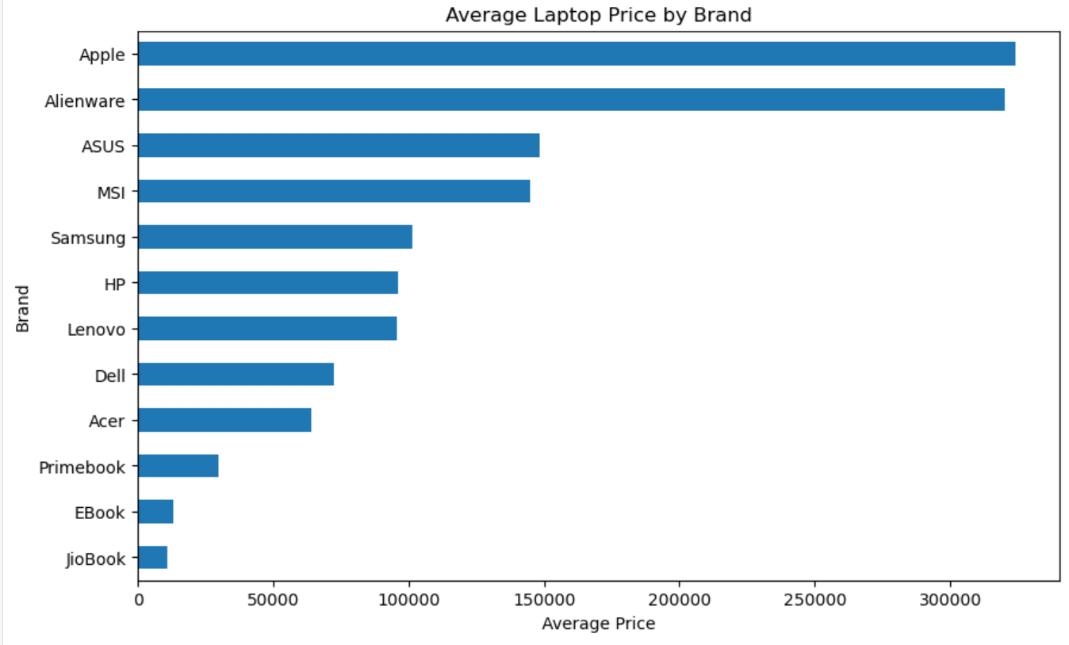
Visualizations and Insights: Visualizations used in the projects are:
Brand Comparison
HP and Lenovo has the highest number of laptops listings, with around 42, that's more than 50% of the market followed by Acer-27 ASUS-19
HP and Lenovo together represents large portion of the listings
Dell being known as a popular brand in the market has considerably fewer than HP, Lenovo
Small brands like MSI, primebook, EBook, JioBook and Alienware contributed has few listings
Brand-wise Pricing
Apple has the highest average pricing (~3.3 lakh) having Macbook pro models with M5 processor, followed by Alienware with ~3.1 lakh due to its high end gaming laptops
ASUS and MSI are also falling into premium segment with ~1.4 to 1.5 lakh
HP, Samsung, Lenovo, falling in mid range as these brands offering the products across budget, mid-range and premium categories
Dell and Acer are relatively affordable brands
Looks like EBook, JioBook, primebook have lowest average prices targeting entry level users

Slide 11
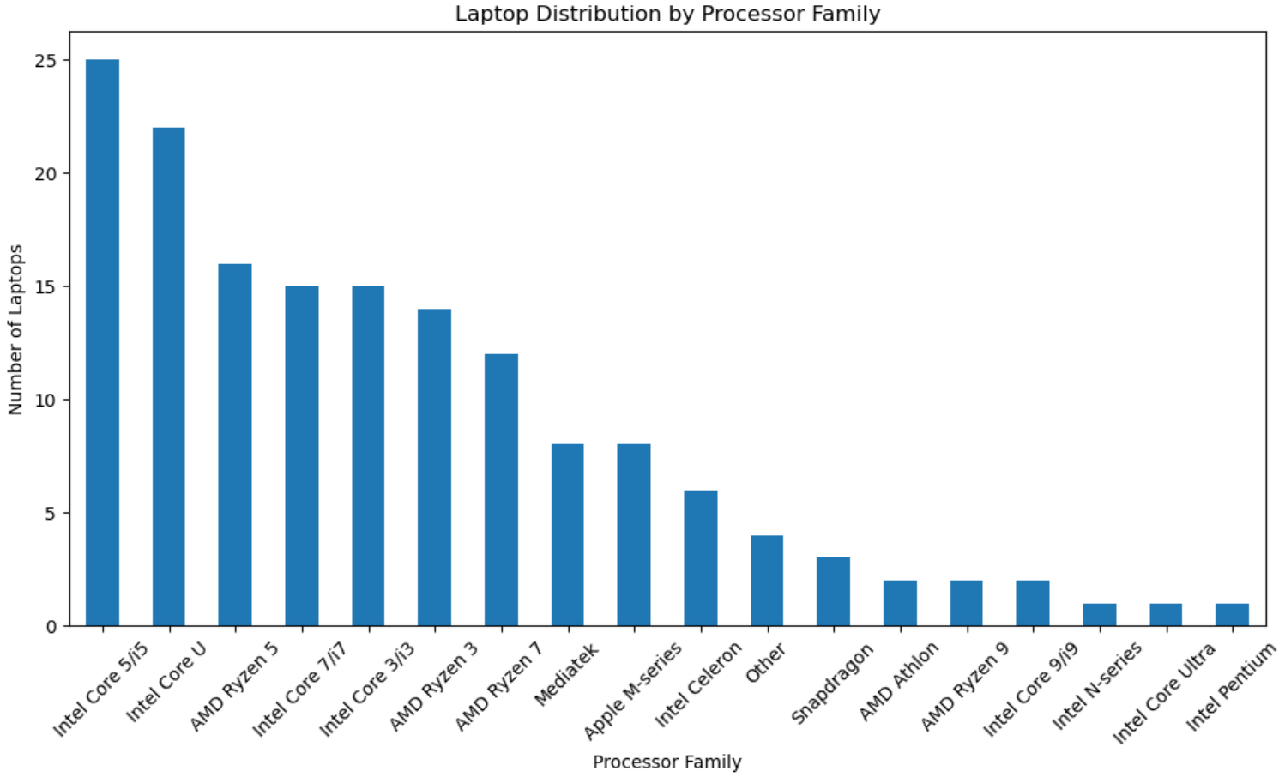
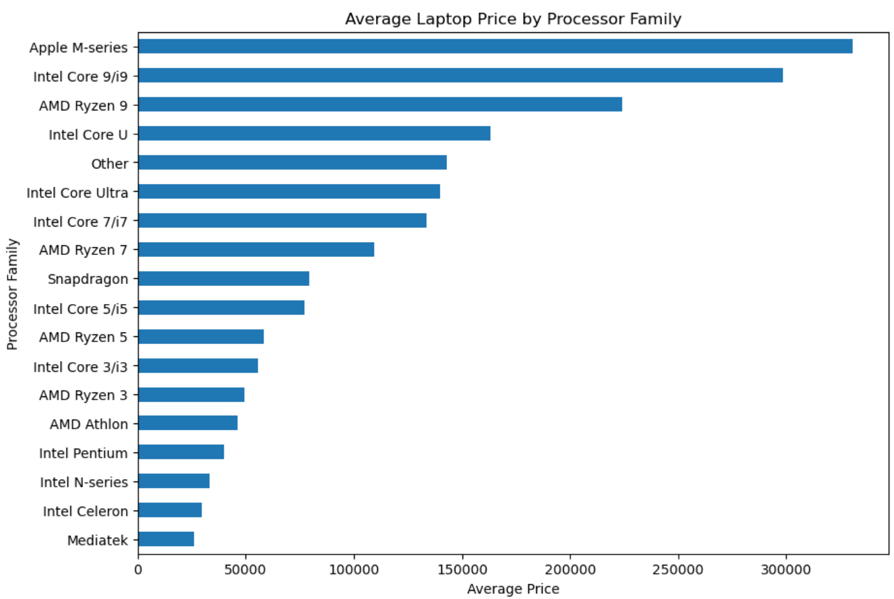
Visualizations and Insights: (Continued…)
Processor Comparison
Intel Core 5/i5 is most represented processor family about 25 laptops followed by Intel Core U and AMD Ryzen 5 with 22 & 16 laptops
Intel Core 7/i7 (19), Intel Core 3/i3 (17) being next lead processor group, the dataset is dominated by Intel processors
AMD Ryzen 3 & 7 have moderate representation with 14 and 12 laptops, together most represented AMD Ryzen category
MediaTek and Apple M-Series has very limited presents
Snapdragon, AMD Athlon, AMD Ryzen 9, Intel Core i9, Intel N-Series, Intel Core Ultra, and Intel Pentium—have relatively few listings
Processor VS Price
Apple’s M-series Processor laptops maintain highest processor laptops maintain a higher average selling price than any competitors
Intel and AMD both maintains a significant share where Intel Core 9/i9 and AMD Ryzen 9 holds highest share followed by Intel Core Ultra and Intel Core 7/i7
Snapdragon, Intel Core 5/i5, AMD Ryzen 5 and Intel Core 3/i3 fall into Mid-Range
AMD Ryzen 3, AMD Athlon and Intel Pentium being lower-mid range followed by Intel N-series, Intel Celeron and Mediatek being lowest avg prices

Slide 12
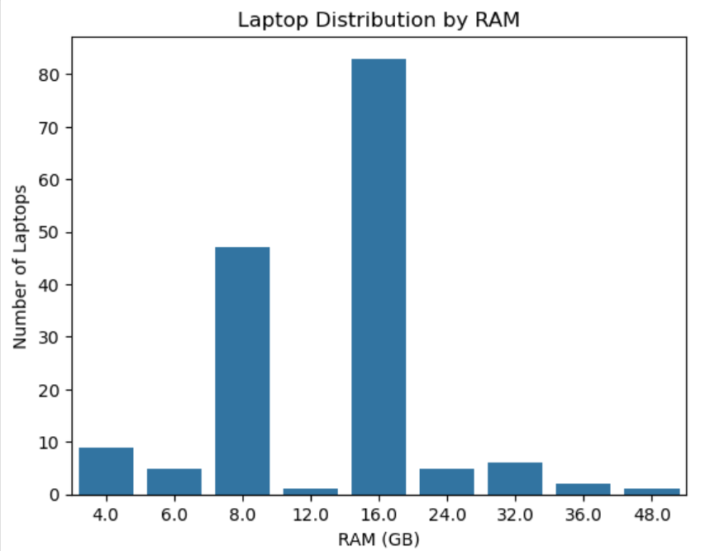
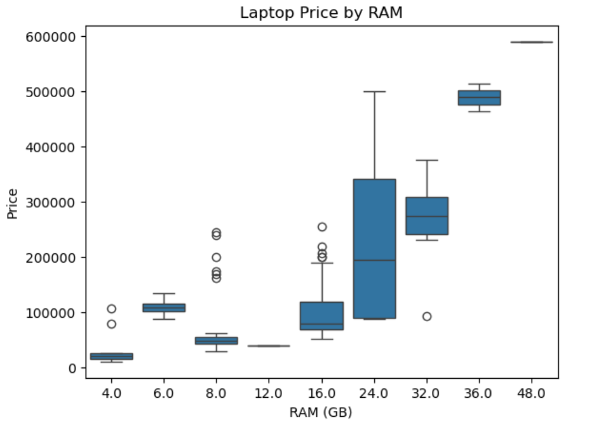
Visualizations and Insights: (Continued…)
RAM Comparison
The distribution is highly concentrated at 16 GB with 84 laptops, this shows that 16GB is the target configuration for most brands
The second largest category is 8 GB, with around 47 laptops. This configuration targets entry-level or budget oriented models
High-capacity tires like 24.0 GB, 32.0 GB, 48.0 GB, 36.0 GB represent smaller, specialized segments
4.0 GB, 6.0 GB has fewer laptops in market and 12.0 GB remains Niche capacities
RAM VS Price
Laptop price trends upward as RAM capacity increases, moving from 20,000 for standard 4.0 GB to 6,00,000 for 48 GB
4.0 GB to 12.0 GB laptops are budget level
16.0 GB to 32.0 GB has laptops from budget level to premium categories
  Outliers are retained as part of project as removing all price outliers would remove part of premium laptop segment
24 GB has wider boxes, indicates mid-tier & High-Performance
36.0 and 48.0 GB holds highest price point in the chart

Slide 13
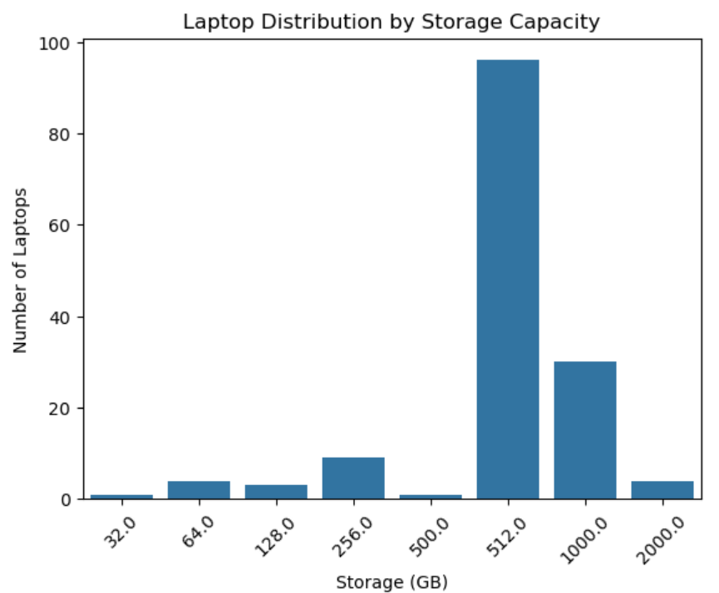
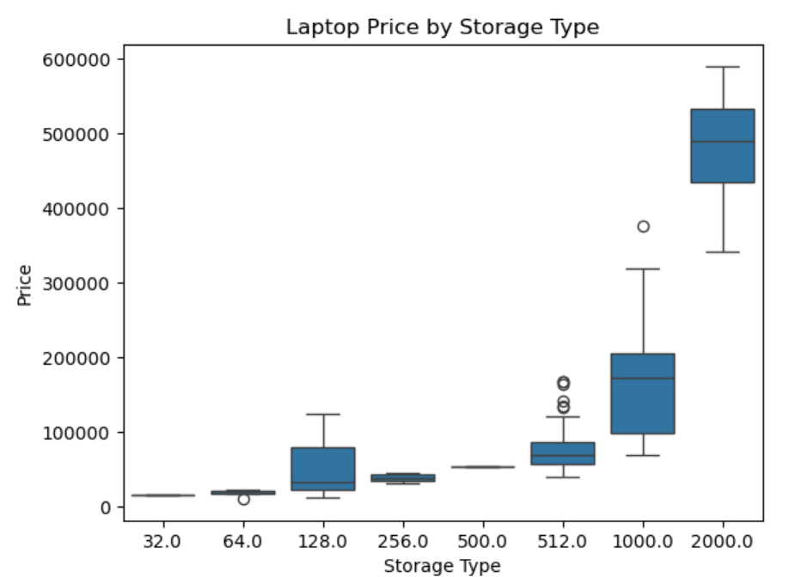
Visualizations and Insights: (Continued…)
Storage Capacity Comparison
512.0 GB is the dominant Market Mode where 62% more than half of the total share
Followed by 1 TB represents 34 laptops. This shows that there is a demand for high storage capacity could be driven by larger software installs and gaming laptops
Storage capacity of 256.0 GB and below collectively has less market around 10 Laptops
32.0 GB, 64.0 GB, 128 GB, 500 GB and 2 TB are very few
Storage VS Price
Just like RAM, SSD also has a strong positive correlation between Storage capacity and Price
There is a massive price leap from 1 to 2 TB, compared from 32.0 GB to 1 TB, 2 TB SSDs into high-end gaming laptops and professional workstations equipped with top-tier GPUs, CPUs, displays, and cooling solutions
512 GB laptops are mostly mid-range, with a few high-priced outliers
Storage alone does not determine price, processor, RAM, and brand also play an important role

Slide 14
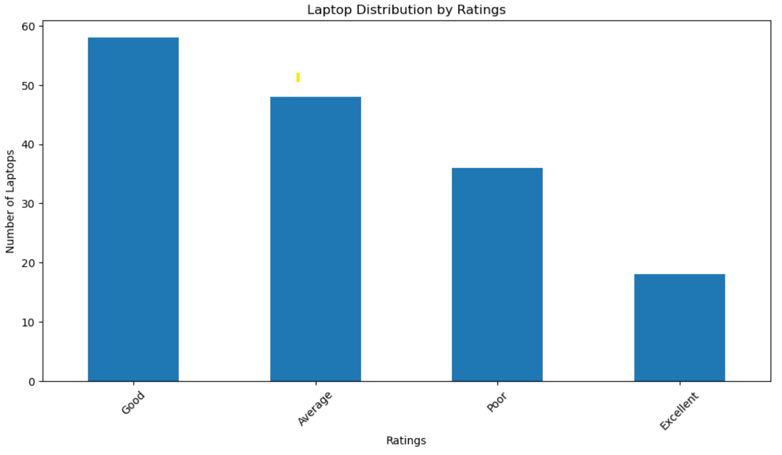
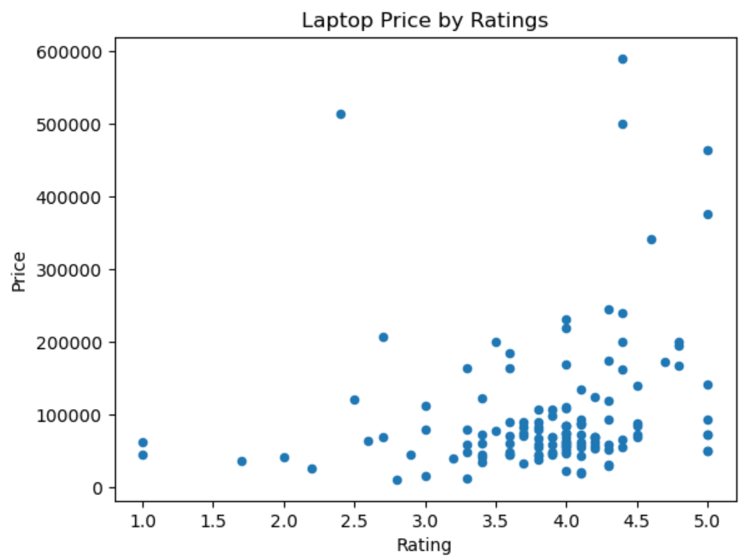
Visualizations and Insights: (Continued…)
Rating Comparison
The overall rating shows that most laptops fall with Good and Average ratings. Premium Laptops show high percentage around 35% for poor and 22.5% excellent ratings. This shows that higher priced laptops does not necessarily fall into higher customer ratings
The larger group of non-premium laptops are Good 38% followed by Average rated 38.3 % only 7.5% are Excellent-rated
Ratings VS Price
Most laptops priced around 1 Lakh are rated between 3.5 to 4.5, Hence there is no direct relationship with higher price and rating
Highest-priced laptops have ratings around 4.4–5.0, but there are also lower-priced laptops with similar ratings
A few laptops with lower ratings also have relatively high prices, this shows price does not guarantee a higher customer rating
Rating_group | Average | Excellent | Good | Poor
LaptopSegment
Not_premium | 35.8% | 7.5% | 38.3% | 18.3%
Premium | 12.5% | 22.5% | 30.0% | 35%

Slide 15
Premium Laptops Insights:
Premium Laptops are considered based on the price threshold, RAM, storage, processor, and brand results describe the characteristics of those high-priced laptops, they are not the criteria used to classify them as premium
25% of the laptops are classified as Premium — 40 out of 160 laptops
HP has the highest number of premium laptops with 10, followed by ASUS, Apple, and Lenovo with 8 each
Intel Core U is the most common processor group among premium laptops, with 13 laptops
Apple M-series is the second most common processor group, with 8 laptops
16 GB RAM is the most common configuration, found in 22 premium laptops
1 TB storage is the most common storage configuration, found in 22 premium laptops
512 GB storage is also common, with 9 premium laptops
Higher RAM configurations such as 32 GB, 36 GB, and 48 GB appear among premium laptops, but less frequently
Conclusion and Key findings:
The analysis shows that laptop price is influenced by multiple factors, including brand, processor, RAM, storage, and other specifications
16 GB RAM and 512 GB storage are among the most common in the dataset
Intel processors have the largest representation, while Apple M-series processors have a significant presence in the higher-priced segment
Laptop prices generally increase with higher RAM and storage capacity, but the same specification can have a wide range of prices depending on the brand and processor
Using the 75th percentile of price as the threshold, 25% of the laptops were classified as Premium and 75% as Not_Premium
  Among premium laptops, 16 GB RAM and 1 TB storage are the most common configuration followed by 512 GB
HP has the highest number of premium listings in dataset, followed by ASUS, Apple, and Lenovo
Customer ratings don't have a strong direct relationship with price. High-priced laptops can have high ratings, and are also found among lower-priced laptops
  Premium laptops show a wider variation in rating groups, with both Excellent and Poor ratings represented significantly
  Overall, a higher laptop price does not necessarily mean a higher customer rating

Slide 16

THANK YOU

